Slide 1


Apps mòbils amb
Introducció a Ionic

Slide 2
Index
What is Ionic?
UI
CSS Components
Javascript
CLI
Folder structure
Demo

Slide 3

What is Ionic?
A frontend framework, built on Cordova, Angular and Sass

Slide 4



What is Ionic?

Slide 5

Apache Cordova
Apache Cordova is a platform for building native mobile applications using HTML, CSS and Javascript.
Notes:
Hybrid Apps: HTML5 that acts like native
Phonegap renamed to Cordova
Web wrapped in native layer
Direct access to native APIs
Familiar web dev environment
Develop a single code base (web platform)

Slide 6

AngularJS
Client-side framework for building webapps

Slide 7

Sass
Sass is an extension of CSS that adds power and elegance to the basic language.
Notes:
CSS generated from the Sass preprocessor
Quickly give your app its own look and feel
CSS designed to be easily overridden
Variables based with default settings
80+ reusable and useful mixins

Slide 8
Pros
Cross-platform: Android, iOS, Windows, Blackberry.
Smaller learning curve if you have a web development background.
Faster development

Slide 9
Cons
Poor performance
Common UI across platforms

Slide 10
Pre-requisites
Node/NPM
Ruby/Sass
(optional) Gulp
(optional) Android Studio or Xcode

Slide 11
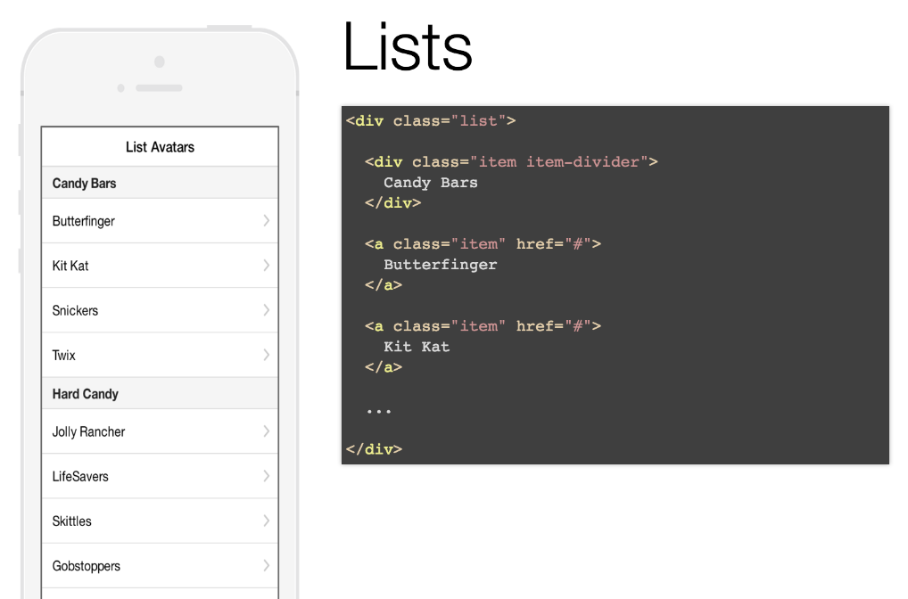
CSS Components

Slide 12
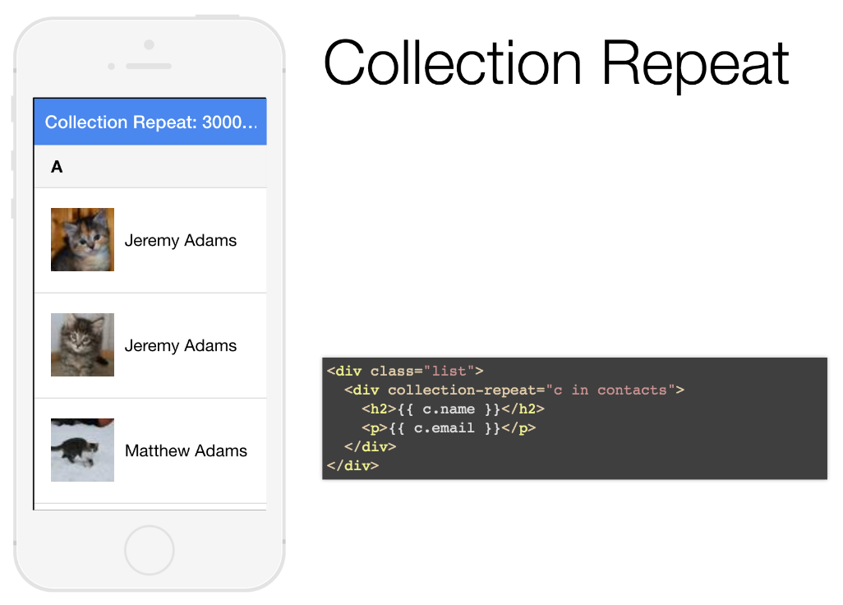
CSS Components

Slide 13
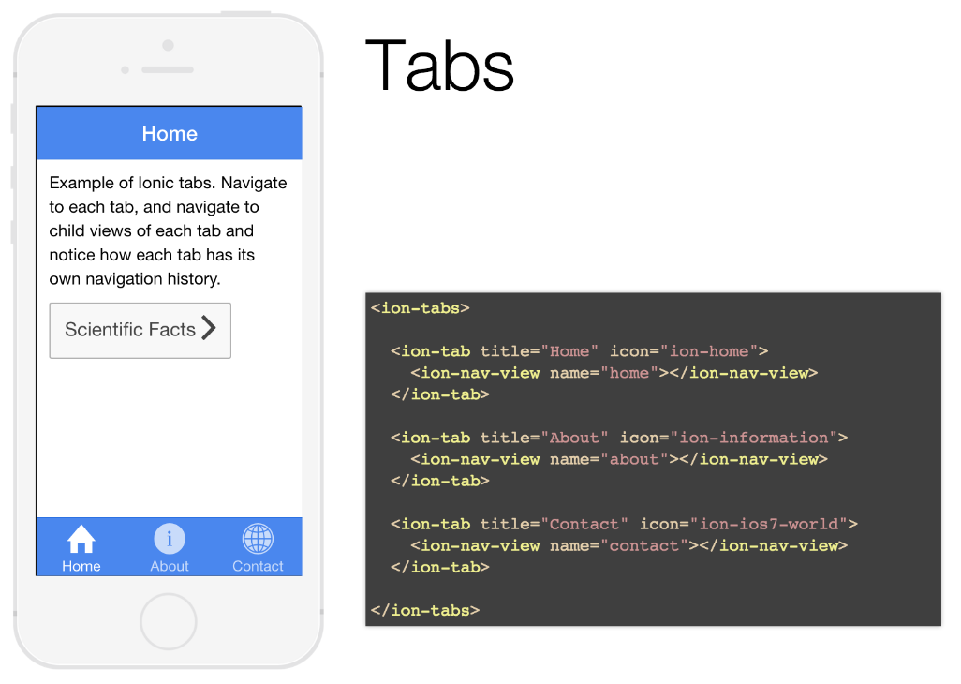
CSS Components

Slide 14
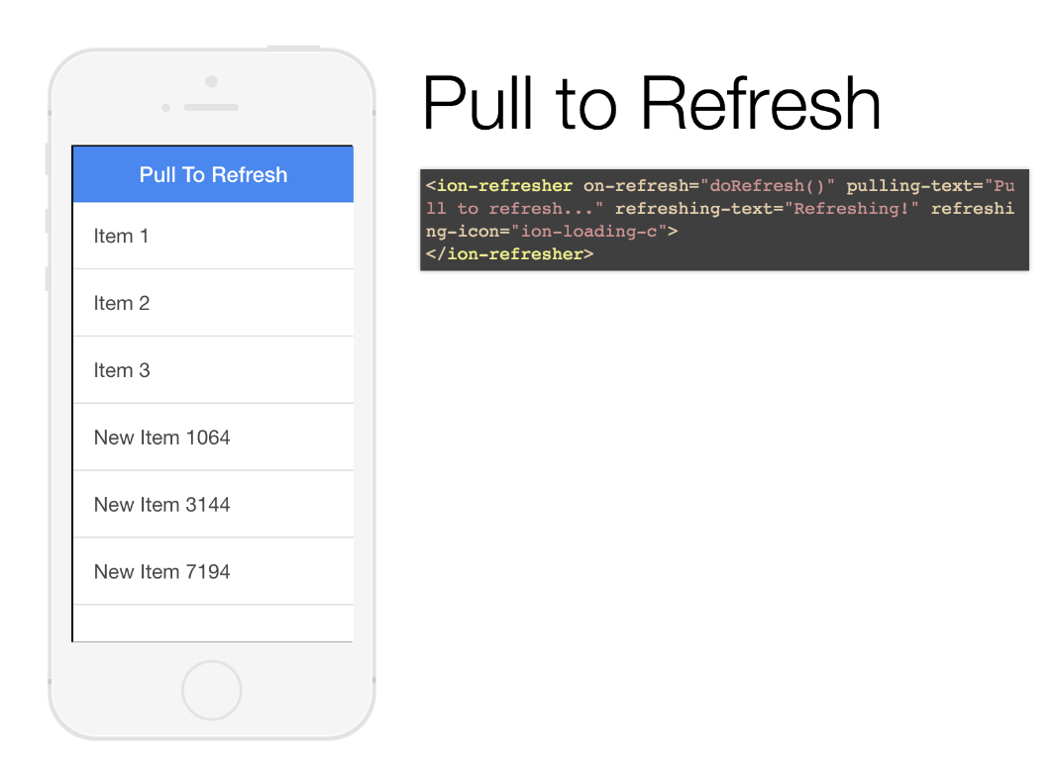
Javascript Components

Slide 15
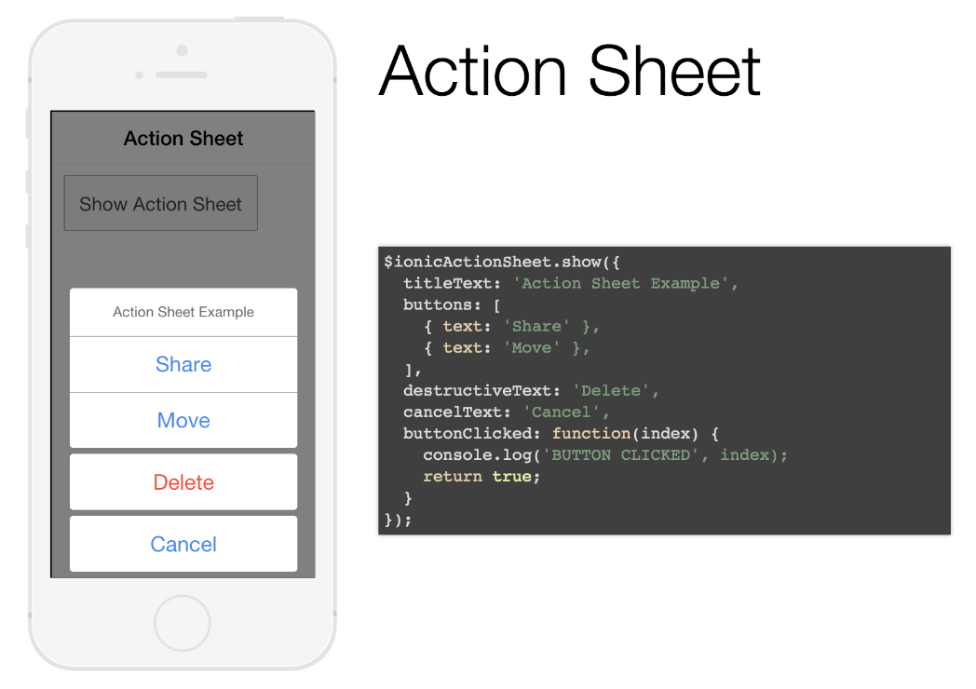
Javascript Components

Slide 16
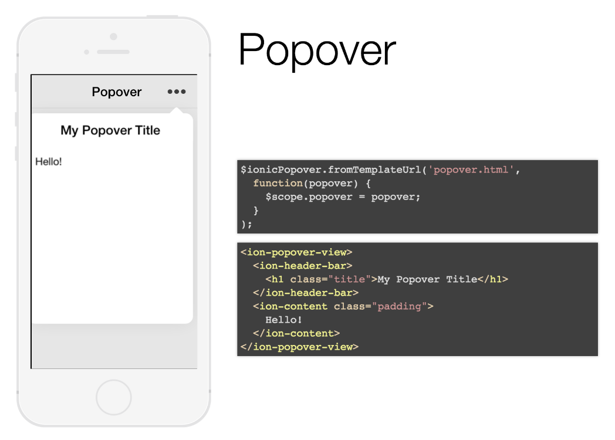
Javascript Components

Slide 17
CLI
ionic start <appName> <template>
ionic serve [--livereload] [--lab]
ionic platform add <platform>
ionic build <platform>
ionic emulate <platform>
ionic help

Slide 18
Folder structure
/hooks Cordova custom commands
/platforms Android, iOS, Windows, etc.
/plugins Cordova plugins
/resources Icon & splash images
/scss Sass stylesheet files
/www Root directory
/www/lib Bower packages

Slide 19
Demo
Install Ionic and Cordova
> npm install -g cordova ionic
Optionally install Gulp and Sass
> gem install sass
> npm install -g gulp

Slide 20
Demo
Create project
> ionic start SeminariFIB tabs
Add platform
> ionic platform add android
> ionic platform build android
> ionic platform emulate android

Slide 21
Demo
Test it in the browser
> ionic serve
See how it will look like in Android and iOS
> ionic serve --lab
See changes live
> ionic serve --livereload

Slide 22
Q&A
Notes:
Presentación de Gavi!

Slide 23
Reference
Getting started guide
ionicframework.com/getting-started
Documentation
ionicframework.com/docs

